Slide 1
Boundary Detection / Image Reconstruction with Multple Spectral Acquisitions

Slide 2
Simulator Setup
Code location: SPIE 2019 -> Boundary Fluorescence -> TumorIDSim
File: main_image_resolution
Spot size: 3mm
Laser settings: 0.2 amperes
Step size: 1mm, 2mm, 3mm
Reconstructed image is created pixel-by-pixel, where each pixel value is an average of all samples taken overlapping that pixel; the classifier value at each acquisition is the 500/545 intensity from the resulting spectra.

Slide 3
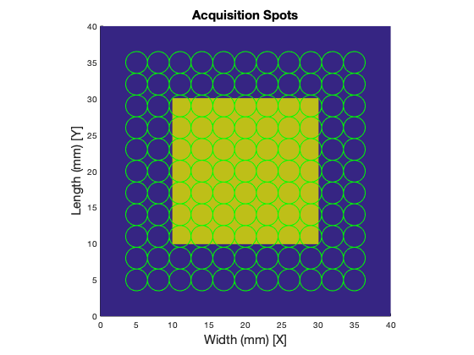
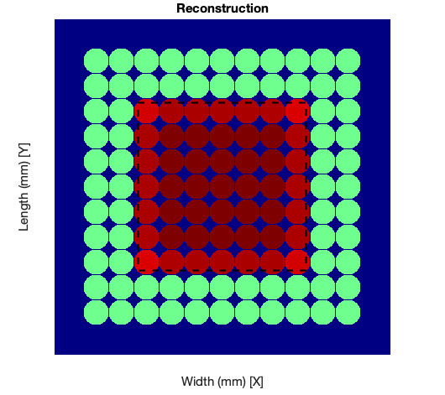
Coarse Steps (3mm between spots)
True Tumor Boundary
Tissue A
Tissue B
Unclassified
Classified: A
Classified: B

Slide 4
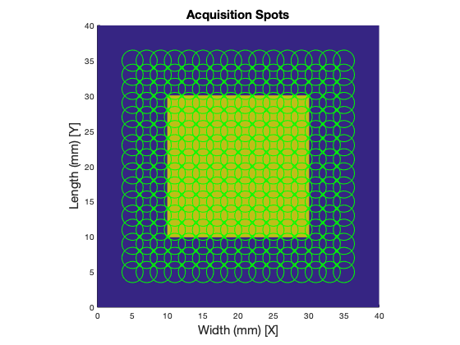
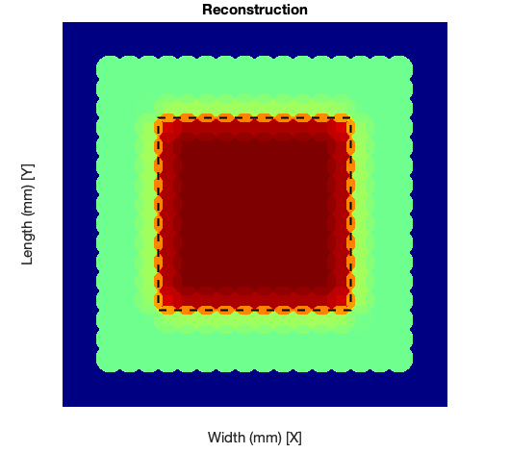
Medium Steps (2mm between spots)
True Tumor Boundary
Tissue A
Tissue B
Unclassified
Classified: A
Classified: B

Slide 5
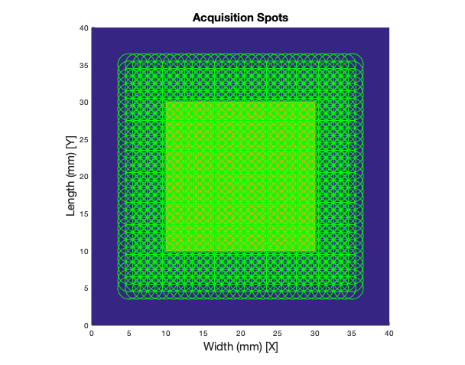
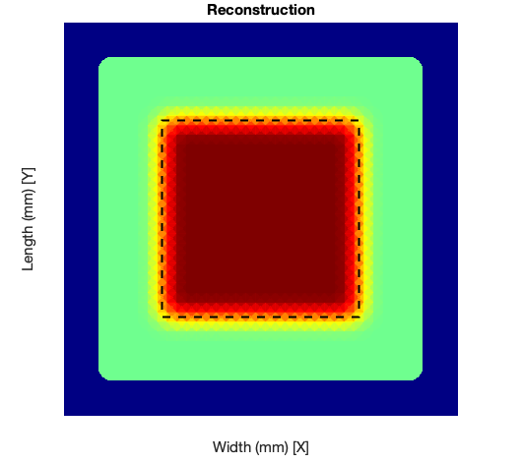
Fine Steps (1mm between spots)
True Tumor Boundary
Tissue A
Tissue B
Unclassified
Classified: A
Classified: B

